Slide 1
SUDOKU GAME

Slide 2
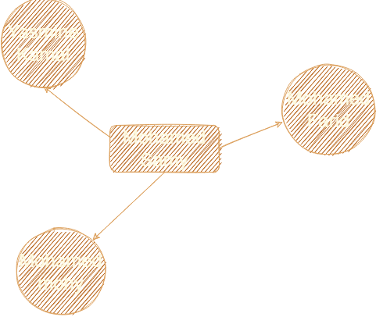
Team member

Slide 3
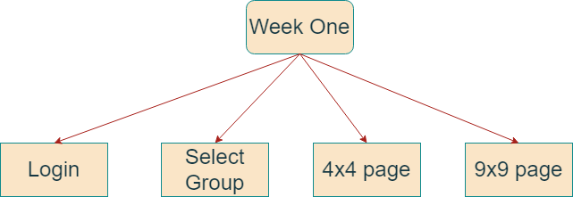
First week

Slide 4
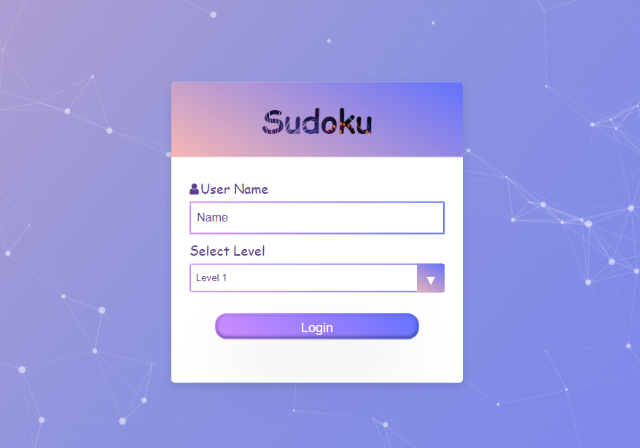
Login page

Slide 5
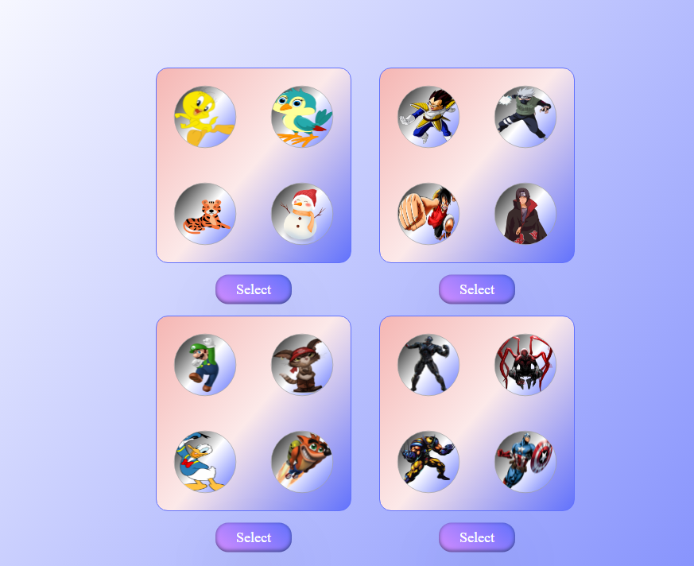
Select group page

Slide 6
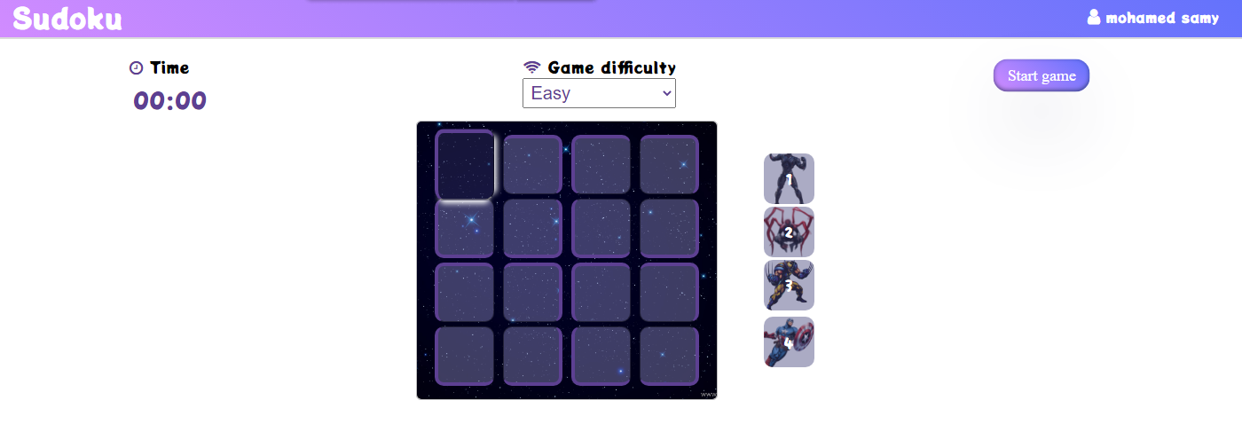
4 x 4 page

Slide 7
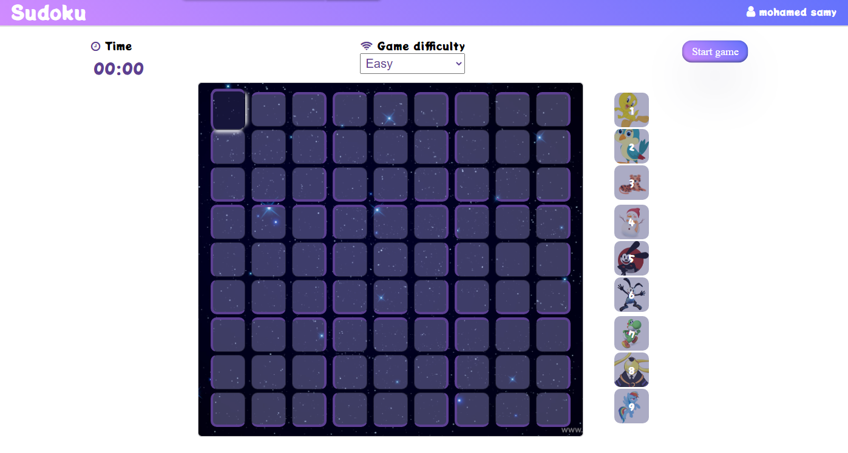
9 x 9 page

Slide 8
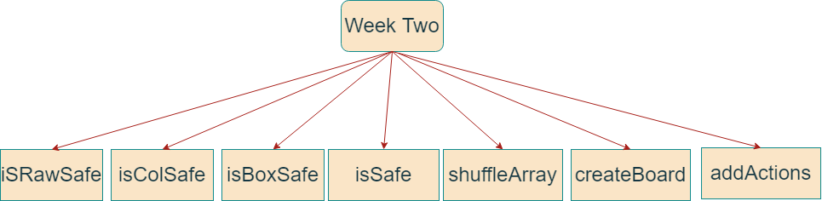
Second week

Slide 9
If start game then create new board
We have three level (Easy, medium, hard)
If select easy → generate board with 8 picture and 4 are free
If select medium →generate board with 6 picture and 6 are free
If select hard → generate board with 4 picture and 12 are free
If(board 4 x 4)
Timer is change from 1 to 3 minute depend on the level;
Else
Timer is change from 3 to 10 minute depend on the level;

Slide 10
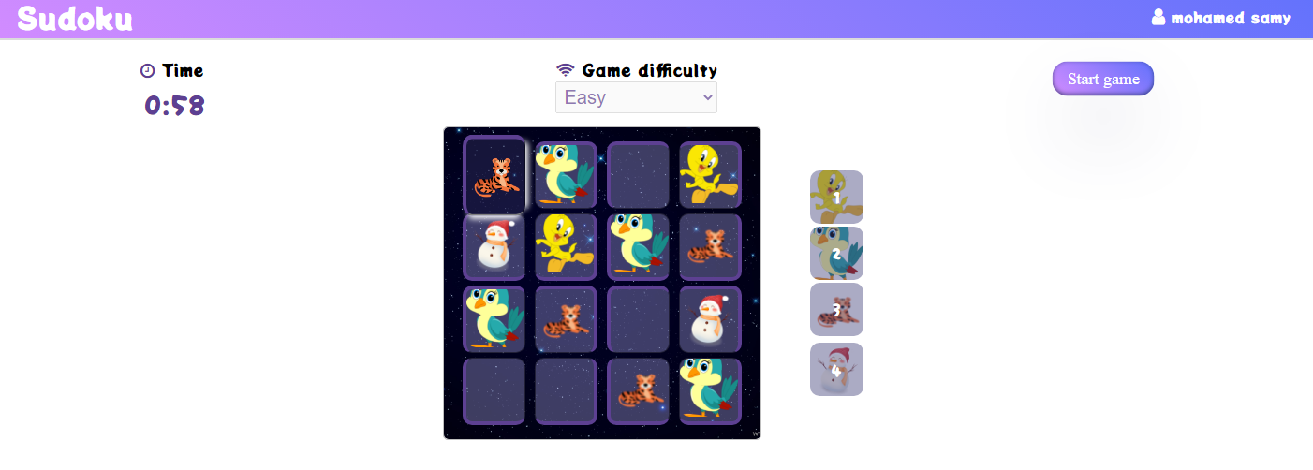
Easy(4 x 4)

Slide 11
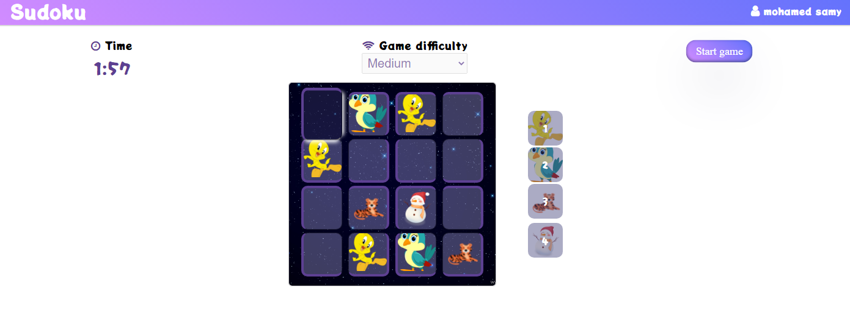
Medium(4 x 4)

Slide 12
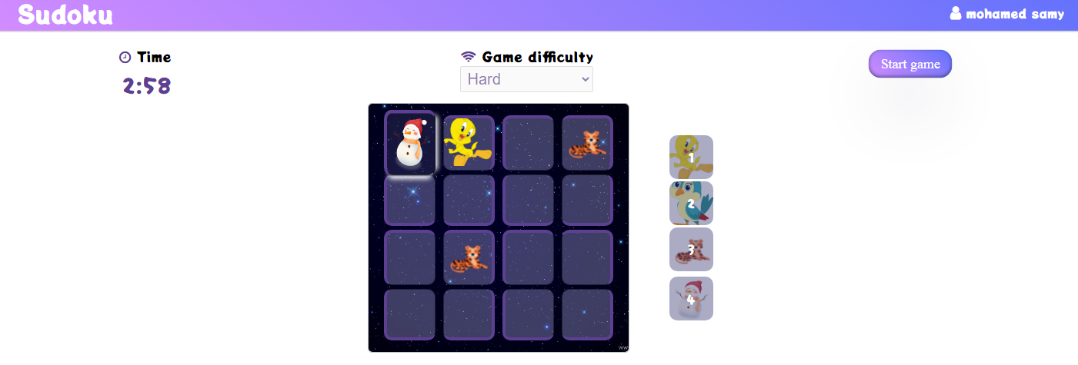
Hard

Slide 13
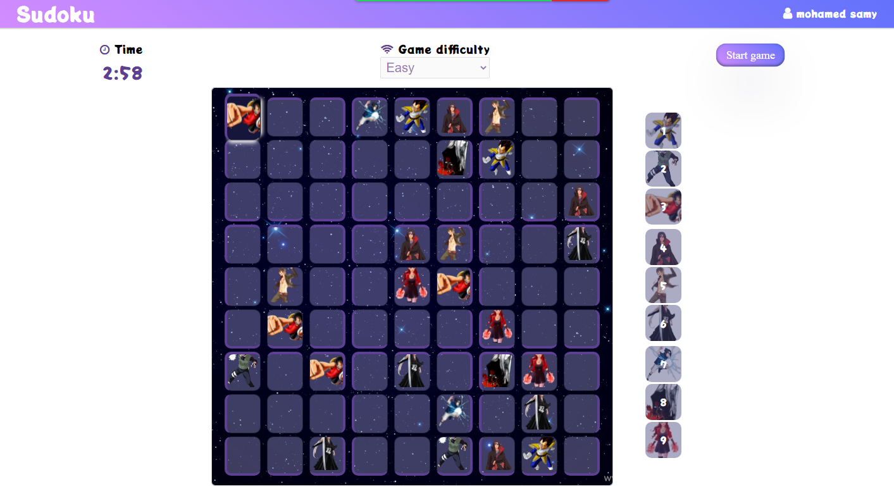
Easy(9 x 9)

Slide 14
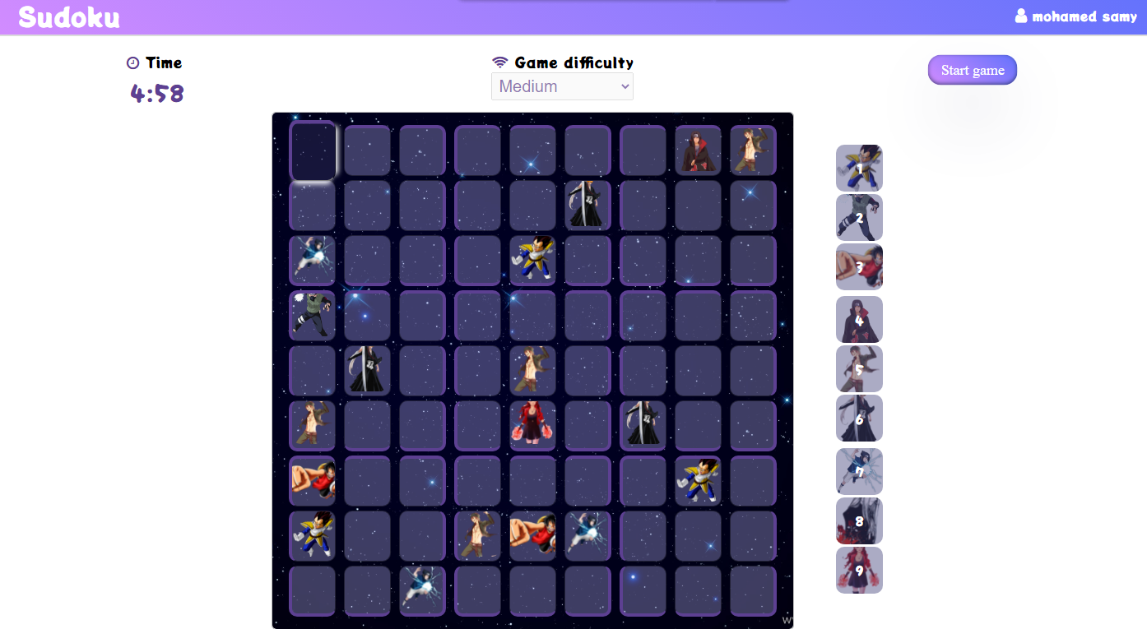
medium

Slide 15
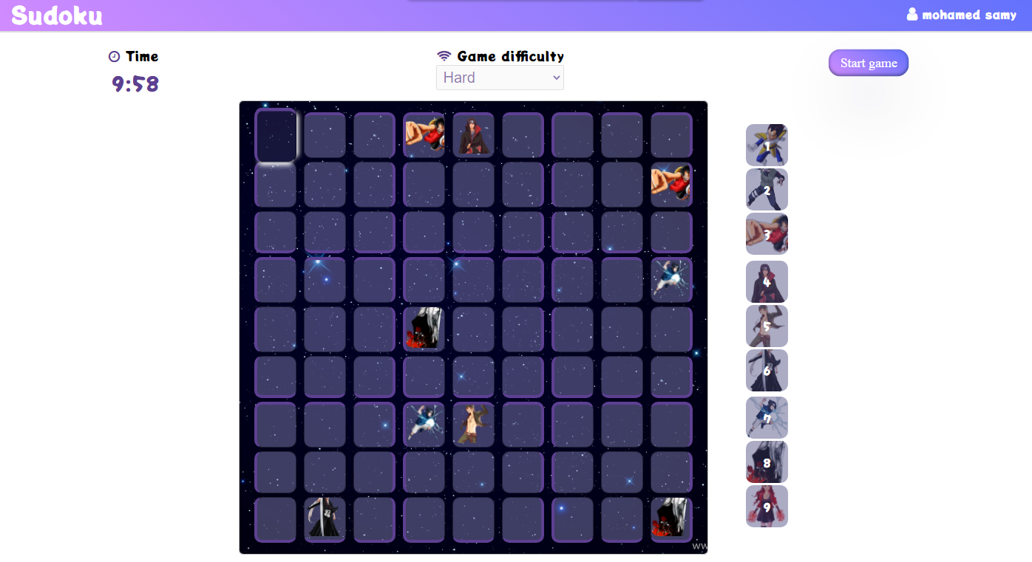
hard

Slide 16
Check error
If the player add new item(image)
Must check isCalSafe && isRawSafe && isBoxSafe
If(return false) generate some animation and red the player show red color in background in each duplicate that image again.
Else
Nothing will happen .

Slide 17
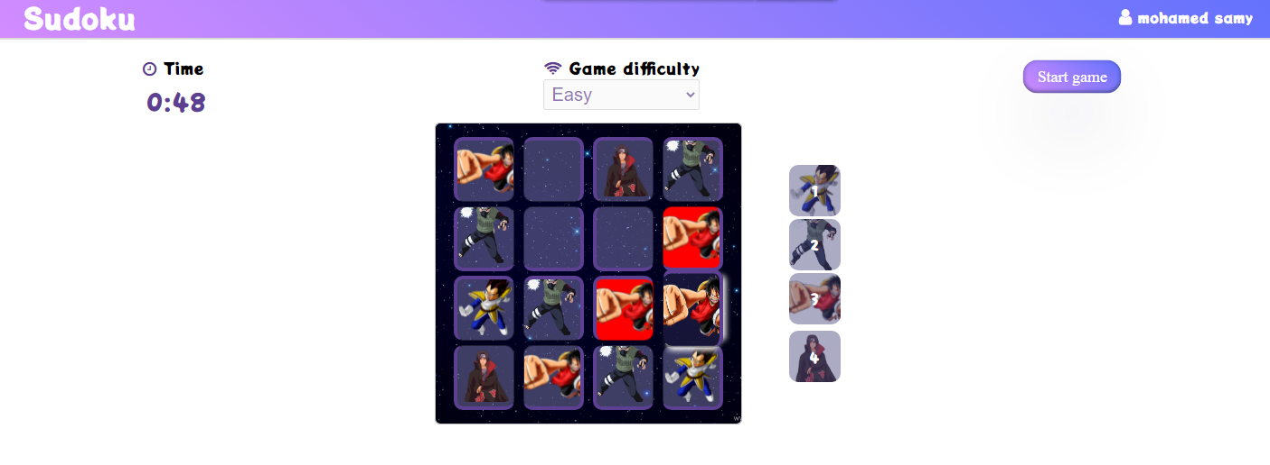
Error in 4 x 4 board

Slide 18
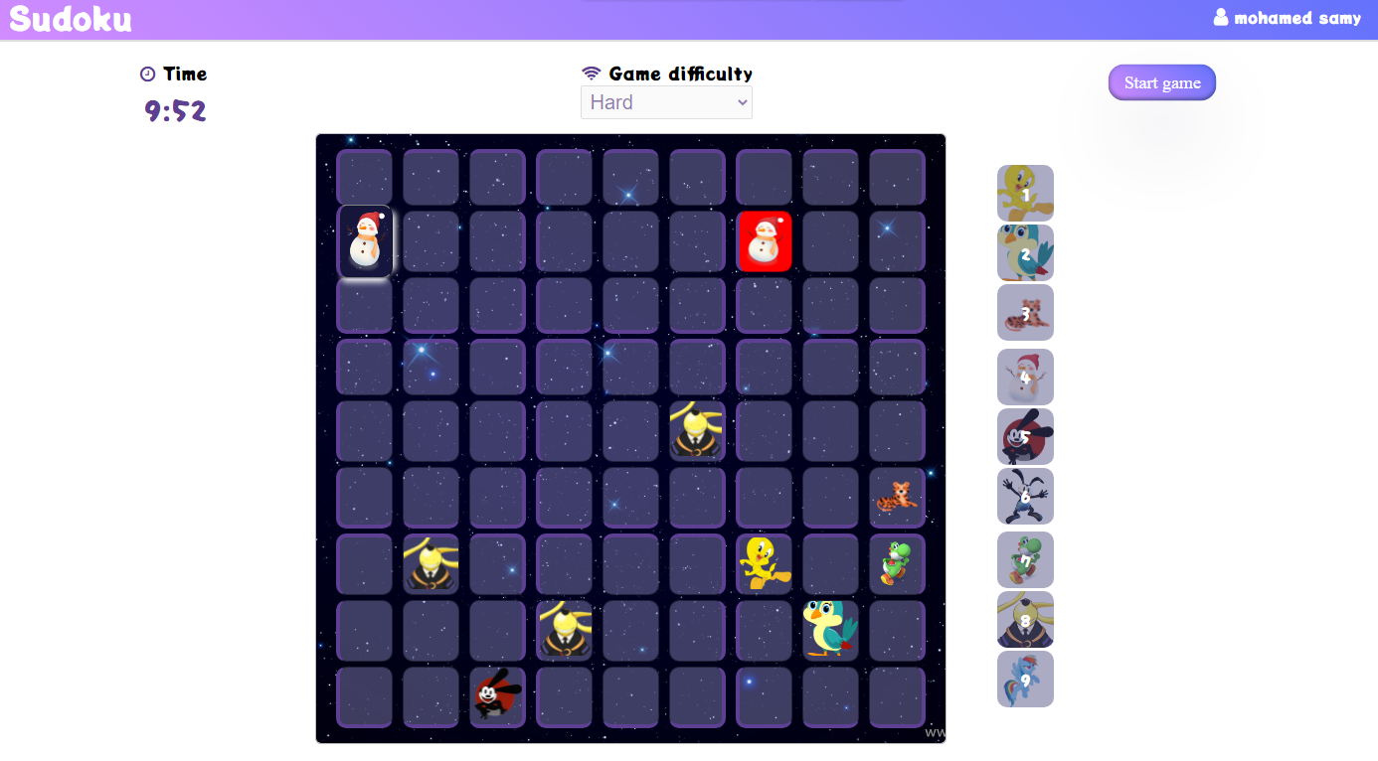
Error in 9 x 9 board

Slide 19
Check the player is winning
If the board if full and all picture invalid or isSafe (not duplicate in same raw and col and box)
The player is win
Else
if the time is end && the board is not full || the board is not valid)
the player is losing.

Slide 20
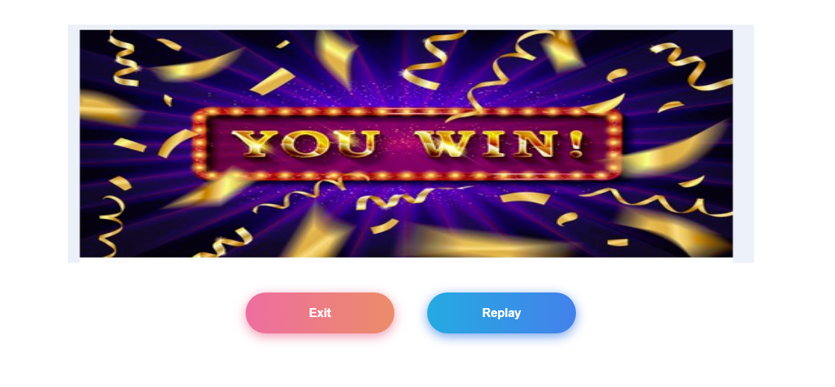
Is win(redirect to win page

Slide 21
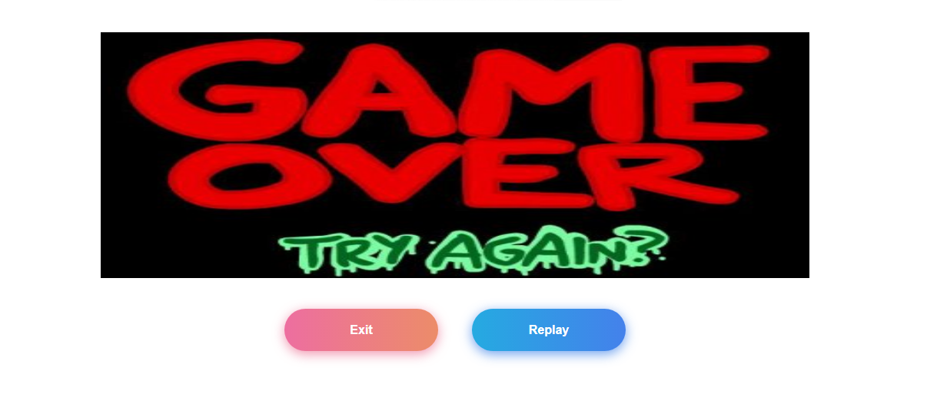
If lose(redirect to lose page

